Slide 1
ROSSMANN STORE SALES
Forecasting sales using store, promotion, and competitor data
Kruthika Potlapally

Slide 2
PROBLEM STATEMENT AND DATA SET
Rossmann operates over 3,000 drug stores in 7 European countries.
Problem statement:
- Prediction of daily sales of 1115 outlets for up to six weeks in advance.
- Influencing factors: promotions, competition, school and state holidays, seasonality, and locality.
Data set:
Train.csv, store.csv, test.csv
Kaggle data set
Train set | Store set | Test set
Historical data including sales Shape – (1017209, 9) Row – Sales of each store on a particular day Column – Store, Day, Date, Open/Close, Promotion, Holidays. Duration – 942 days | Supplemental information about stores. Shape - (1115, 10) Row – Store Column – Store, Store Type, Assortment, Competition, Promotion | 1. Historical data excluding sales 2. Shape - (41088, 8) 3. Row and Columns – Same as train set excluding sales. 4. Duration – 6 weeks

Slide 3
EXECUTION
Data pre-processing and cleansing.
Merging data sets.
Checking for outliers, dropping/filling up of null values.
Feature engineering.
Dummy values for categorical variables.
2. Basic statistics and visualization
Few stores and assortments have higher sales.
Maximum sales are on Saturdays and Sundays and minimum on Fridays.
Most stores face competition.
Sales are slightly higher in March, April, May and October, November, December
Sales are higher during promotions
Sales are very low on a state holiday but high on a school holiday and even higher on a school holiday with a promo.
Outlier- 52 stores open without sales and customers
3. Feature selection
4. Multiple linear regression
Bad model
Very high RMSE

Slide 4
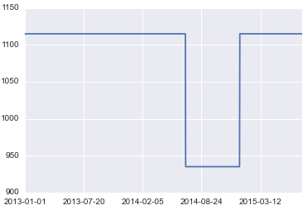
NEXT STEPS
Filling up the gap in train set for few stores.
Modeling :
Time series analysis – ARIMA model or
Random forests ???

